Slide 1
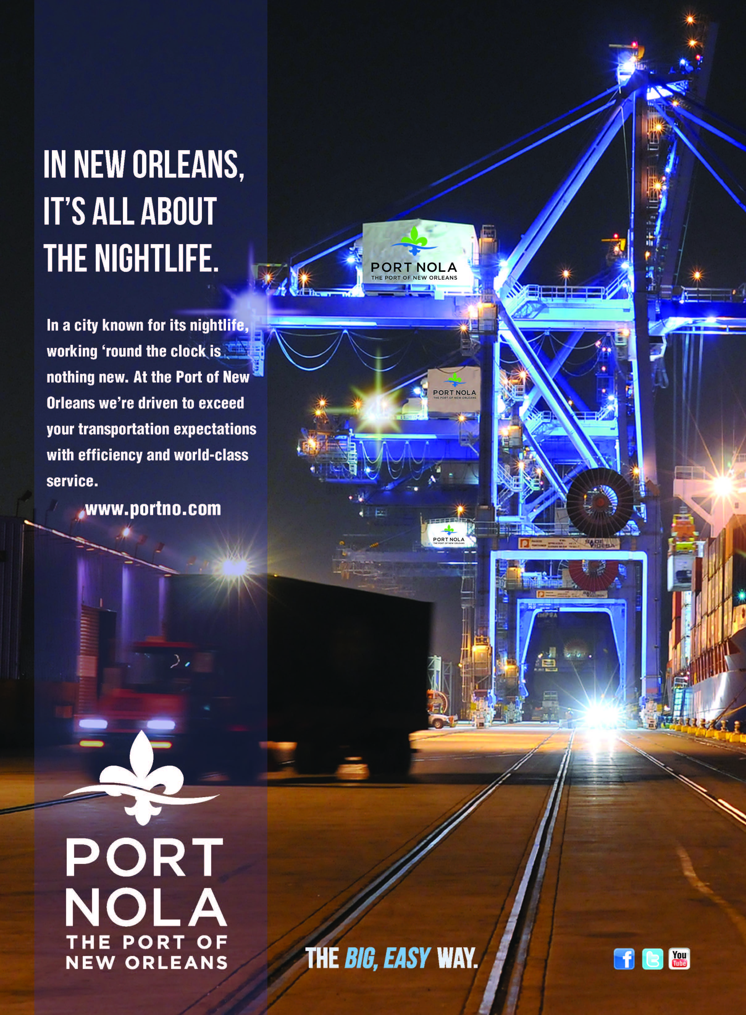
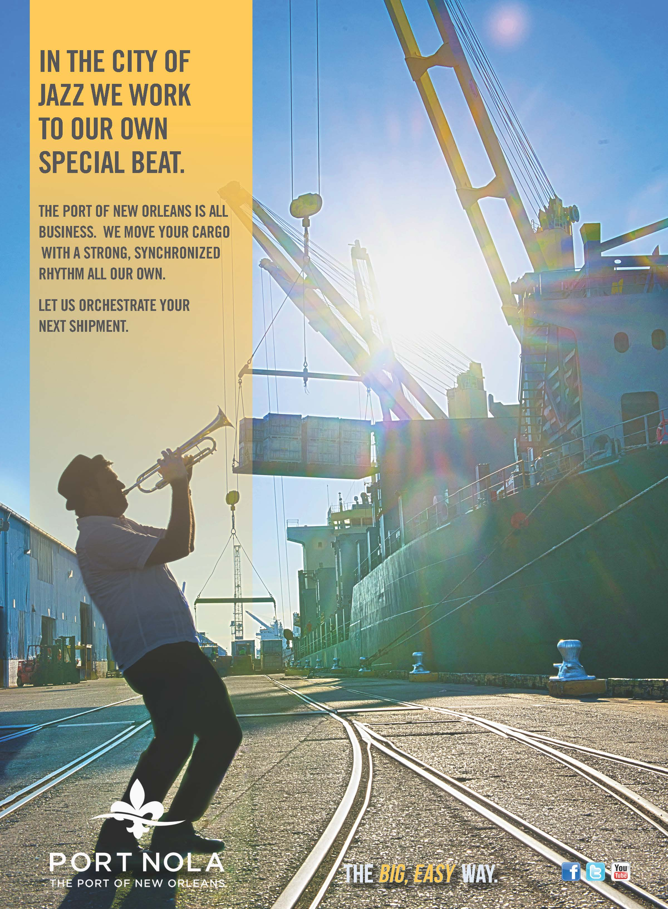
Port of
New Orleans
Big, Easy Way Ad Campaign
Advertisements - Series

